Slide 1


Hackathon 2022 Coding for a Better Community
Don’t unpack your stuff yet!
9:50am+
tinyurl.com/uwg-hack-22
Notes:
TEAL _ open Slide 35 for display
Implementation Plan: https://docs.google.com/document/d/16VcrdiMs8v38hDMZHwU03WpZlvjmOVfL4V7qcz3d9r4/edit#
Start Room 101
Login to Computer
[details]
Open This Music: https://www.youtube.com/watch?v=2gm45F4csOY
Open This Slideshow: https://tinyurl.com/uwg-hack-22
Welcome kids as they come in.

Slide 2
What is this Hackathon about?
Create an application with a positive impact on our community.
Learn some coding.
Have fun.

Slide 3


Our Community starts with our Sponsors
Notes:
We appreciate our sponsors who help make this day possible.

Slide 4


Notes:
Computer Science
Biology

Slide 5

Notes:
Educational Technology and Foundations

Slide 6

Notes:
Morgan
Kristen
Mary Ellen

Slide 7

Notes:
Snacks Galore

Slide 8


Slide 9
Schedule
9:50 - 10:30am | Opening talks, team forming | Here in Room 101
10:30am+ | Code start | TEAL Room Downstairs
12:30pm | Lunch | Lobby Upstairs
3:15pm | Code Stop | TEAL Room
3:30 - 4:15pm | Youth Presentations | Room 125 Upstairs
5:00 - 5:30pm | Awards | Room 125 Upstairs

Slide 10
Ice Breaker: Who are You BINGO
Your name on paper.
25 slots
3 minutes
Ready, set….
Notes:
25 names or 5-minute BINGO -- LINK
1 minute intro and passing out cards
3-4 minutes BINGO meet n greet
2 minutes BINGO wrap up

Slide 11
Presenting Today’s Challenge

Slide 12
Dr. [Name]
Assistant Professor of Health
& Community Wellness
presents…
Scratch the GreenBelt

Slide 13
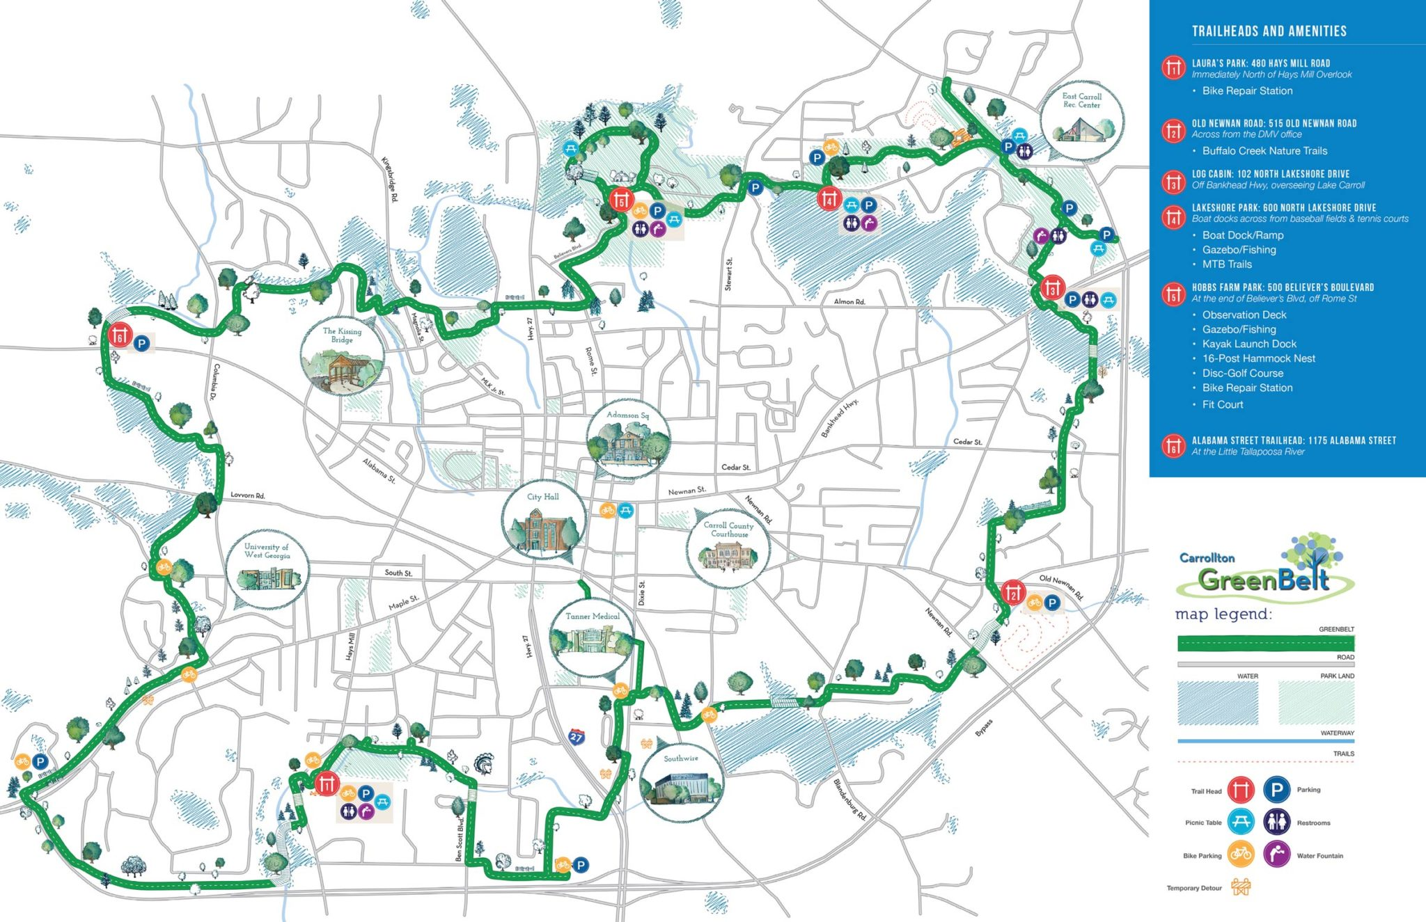

Slide 14
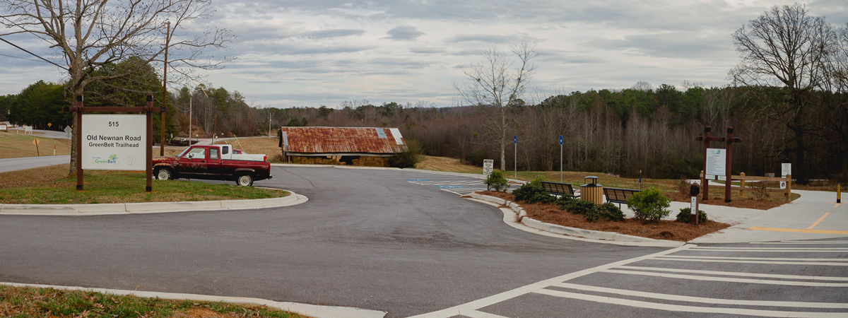
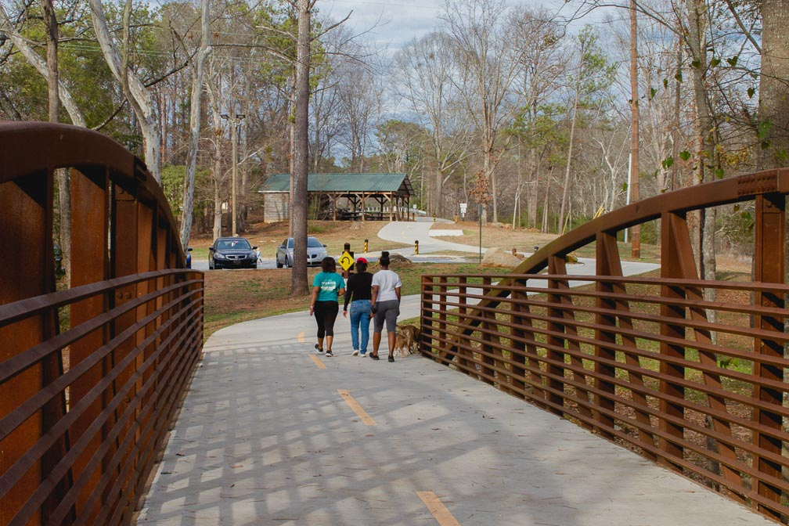
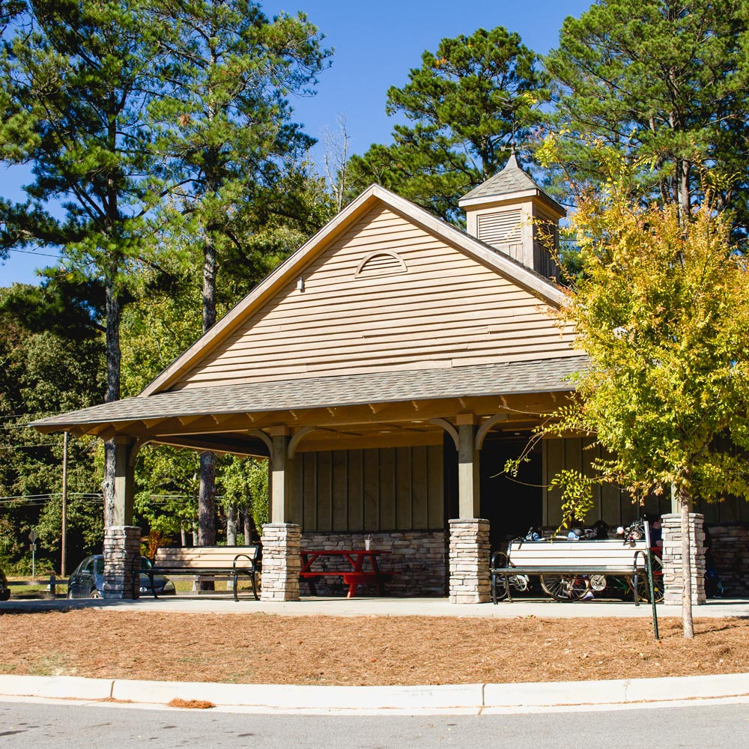
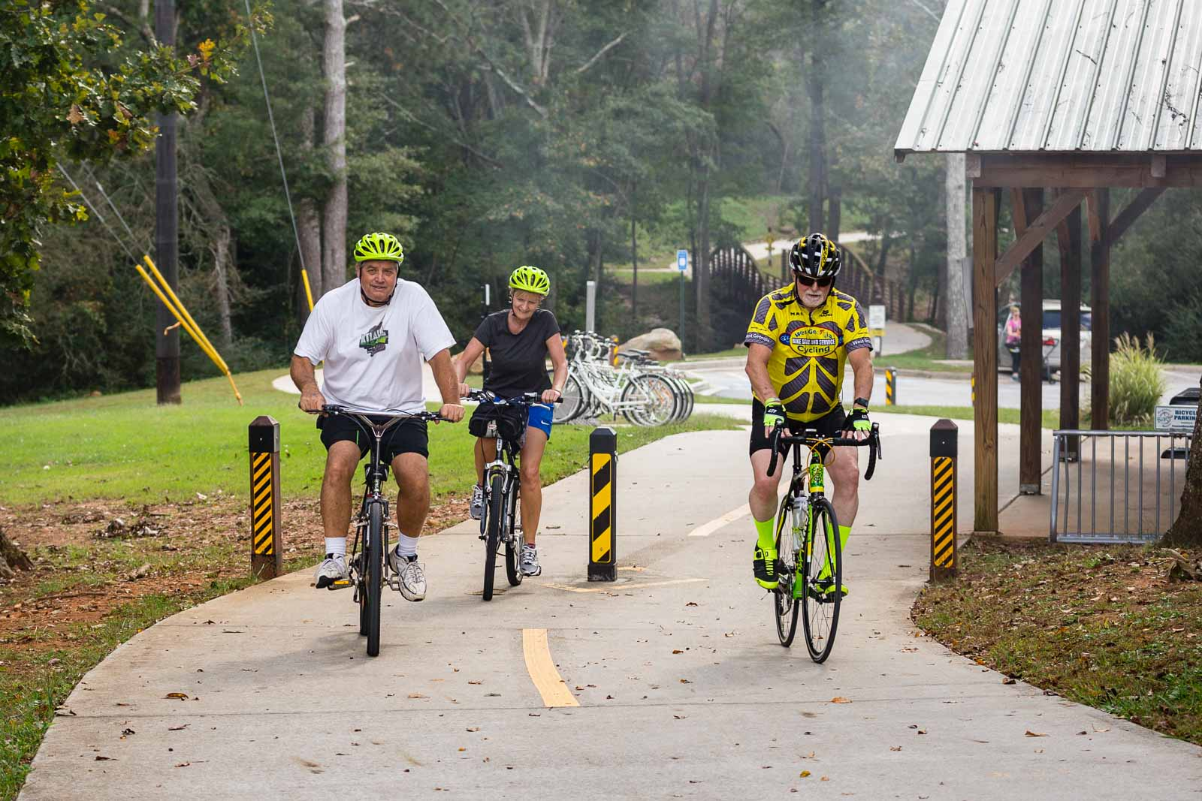
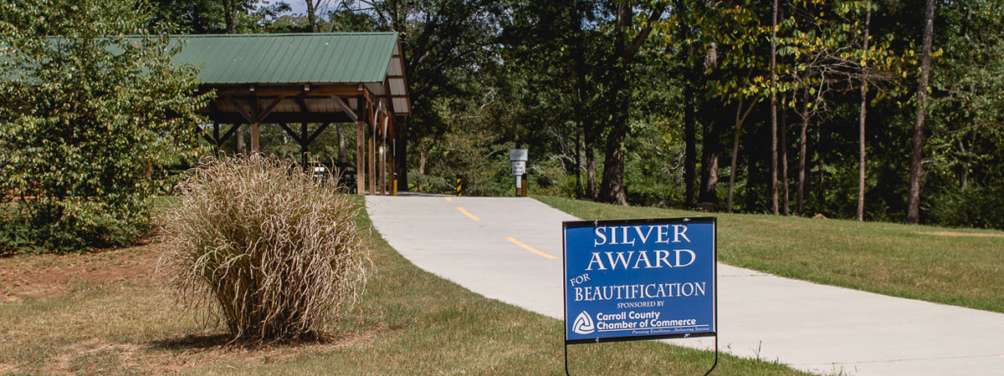

Slide 15
Your Team Challenge: Design a Scratch Project...
Option 1
...that measures trail participation on the Carrollton Greenbelt.
Option 2
...that provides clear access directions to the Carrollton Greenbelt.
Option 3
...other ideas related to something you could create related to broadening awareness of the Carrollton Greenbelt?

Slide 16
Today’s Hardware and Software in the Work Space

Slide 17


“Low-floor, high-ceiling”
Games, apps, animations, presentations, etc.
Web-based: scratch.mit.edu
[+ Backup Plan]
Notes:
Show of hands → Familiarity with Scratch

Slide 18
Software
Each team’s desktop computer has:
A web browser to use Scratch (https://scratch.mit.edu/)
(Back up Plan: Scratch downloaded onto desktops).
Each team needs:
At least one Scratch Login that has been confirmed through email,
To understand Scratch performs best when 1 person is logged in and making changes (divide tasks, collaborate).

Slide 19
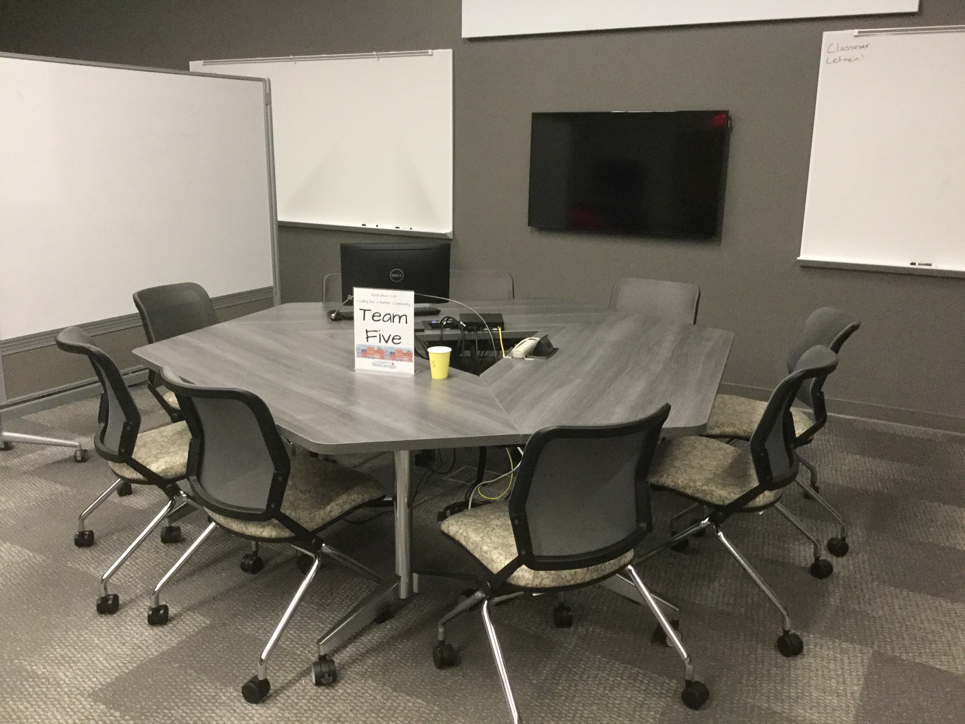
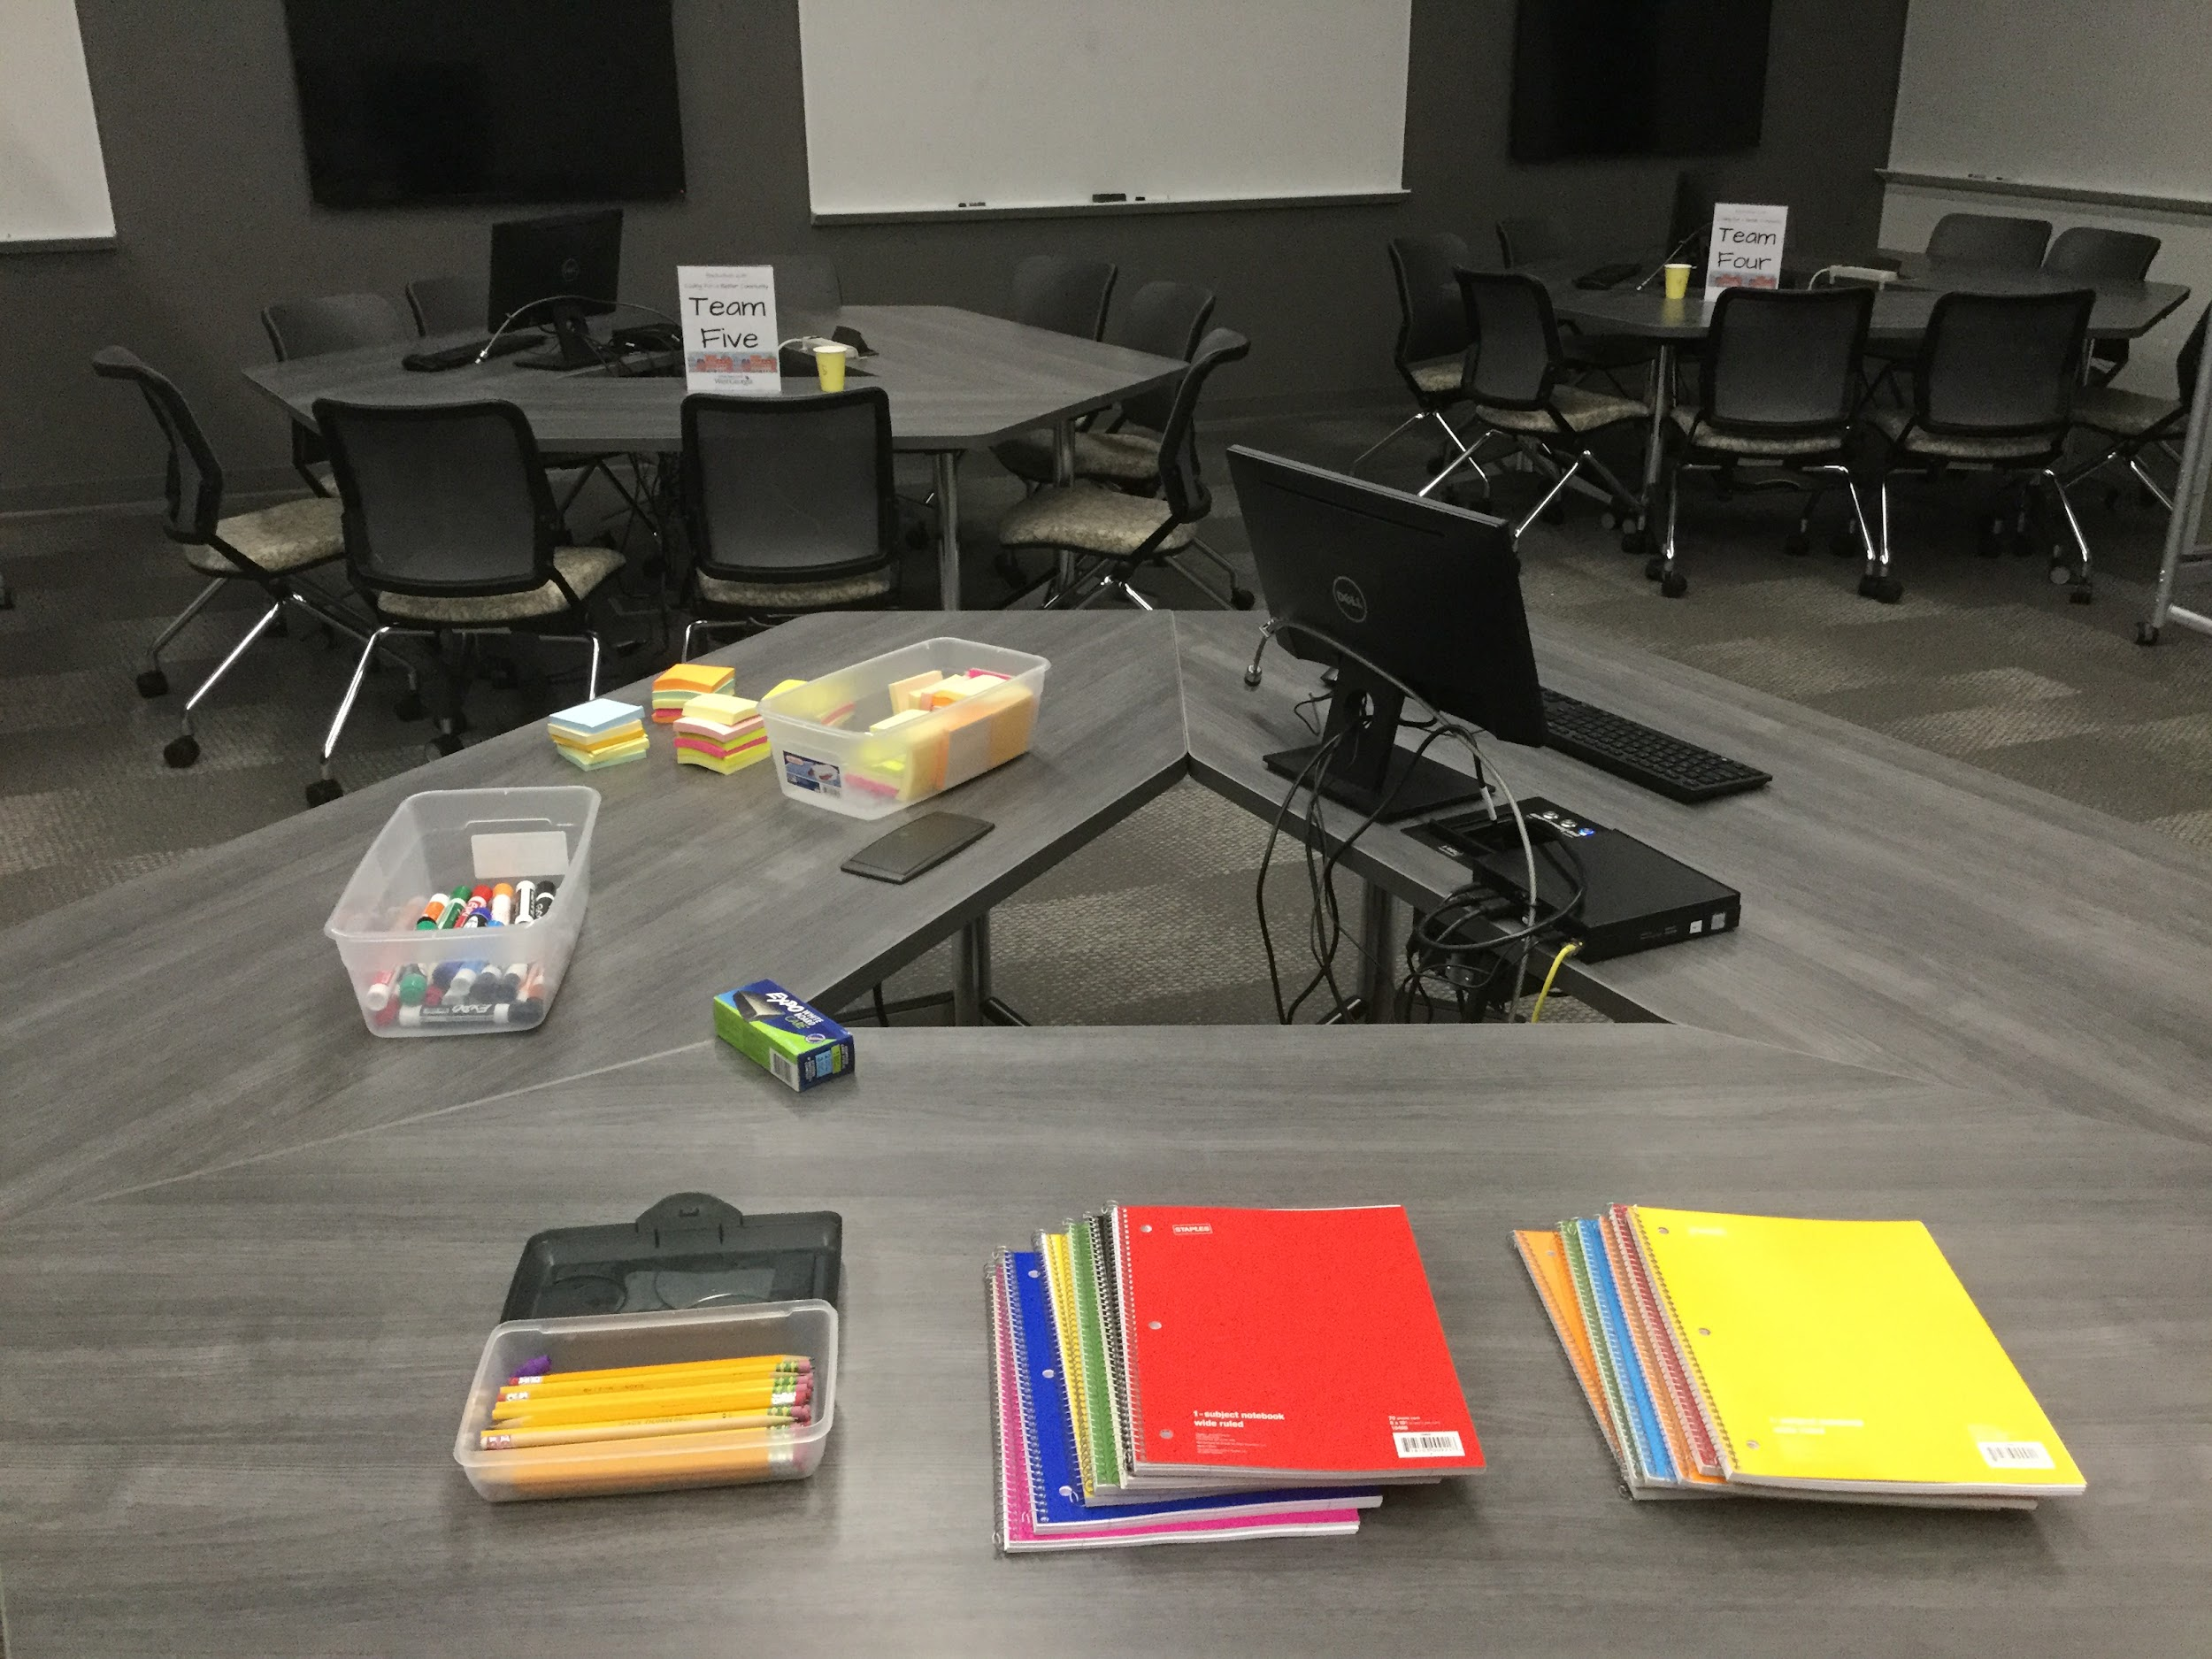
TEAL Room
Team work station. Use supplies from resource table.

Slide 20
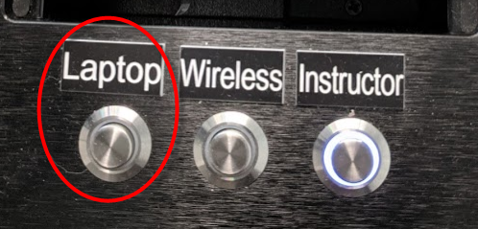
Hardware Setup
In TEAL Work Space, each team has:
Desktop computer with internet access to implement the project
Login info in your Team Packet
Wall-mounted screen for larger display.
Marker whiteboard for brainstorming ideas.

Slide 21
Additional Possible Hardware
In TEALS Work Space, each team may also:
Connect laptops or other devices to SecureWest [WiFi].
Check out a Chromebook (limit 1 per team).

Slide 22
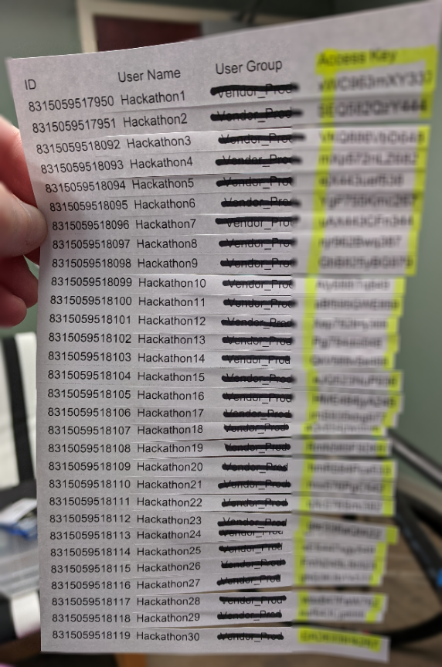
RE: Today’s WiFi
Each participant issued individual 12-digit access code
By Mentor: Tracey
At Supply/Mentor Table
In TEAL Room
Each code connects up to 5 devices
Alternatively: Guest Access thru Welcome West+Secure West (more complicated)

Slide 23
Introducing Our Mentors

Slide 24
If you need help, ask a mentor.

Slide 25
Your Mentor Team
Witt, UWG Maker Space
Brian, AHC
Michael, AHC
Dexter, AHC
Caviaye, UWG ITS
Tracey, Microsoft TEALS and UWG CS
Anja, UWG CS
Jonathan, UWG CS
Charity, COE Innovations Lab
Mentors, please stay in this room with me a second after teams go to TEAL room.

Slide 26
Work as a Team
Embrace different ideas.
Make compromises.
Leverage the different skills of your team members.
Split the work and assign tasks to everybody.
Program in pairs.
Notes:
Selected mentors speak to the topic of team work in the software development setting. In 2022, it was members from the local tech firm Across Health Care who spoke to this.

Slide 27
What Comes After You Develop Your App?

Slide 28
Presenting Your App
3:15 pm: Code Stop
3:15-3:25: Pack up and head upstairs to 125
All team members present when presenting for the judges.
Presenting to whole group, including Advanced Track and any family or friends.
Think about how to show off/communicate your work.
3 minutes to Present. 1-2 minutes for Questions (5 max)

Slide 29
Publishing and Submitting Your Project
Submit the link to your published project to Google Form
tinyurl.com/hack22submit
Must be published.
No logging in at presentation station.
You may submit 1 additional URL to other artifact (Google Slide, Infographic, Prezi, etc.)
More Details around 1:30pm.

Slide 30
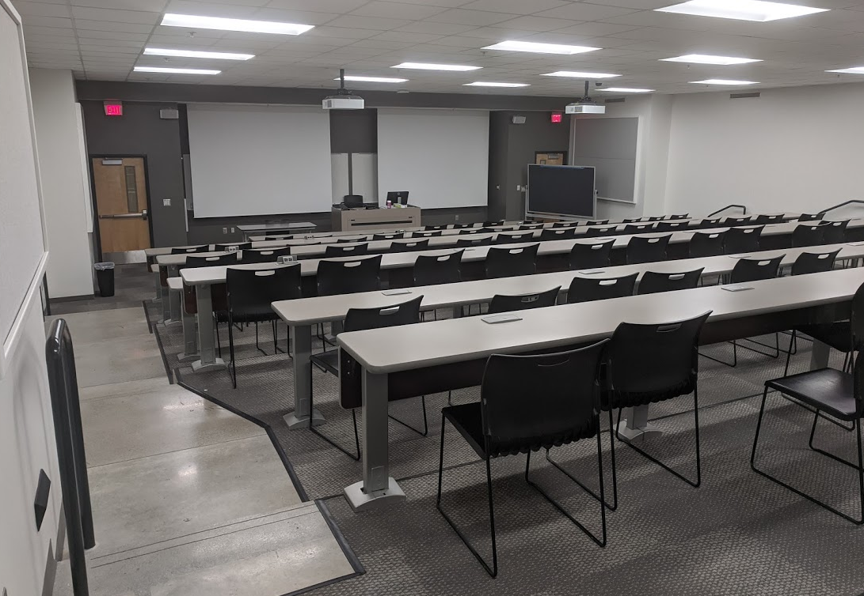
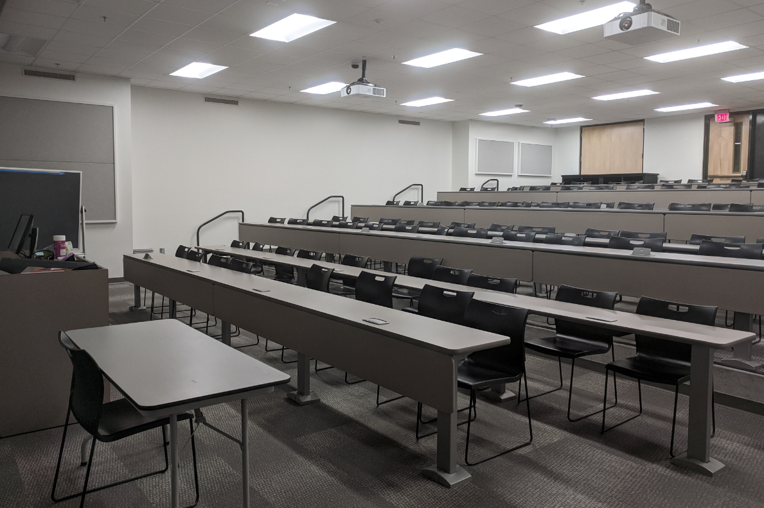
Presentation & Awards Room

Slide 31

Three Awards
Selected by judges
Computing Excellence
Creativity
Highest Impact

Slide 32
Computing Excellence Award
Criteria
Implemented functionality
Robustness
Variety of used programming features
Readable, well-structured code

Slide 33
Creativity Award
Criteria
Unique or Provocative Idea: Took the theme in an unexpected direction that is thought provoking, attention grabbing, and memorable.
May be expressed through any aspect of the work (e.g., user interface, content of story, coordination of teamwork, creative graphics, captivating application or story, user-friendliness, etc.).
Notes:
Great attitude award

Slide 34
Highest Impact Award
Criteria
Meets the Hackathon theme
Clearly defined purpose
Meets its purpose
Suited for target users

Slide 35
Team Formation

Slide 36
Already have a team of 2-4?
Grab your stuff.
Go to our helper at the other end of the room.
Get your team packet with Team #.
Go to the TEAL Room to Your Assigned Table.
Fill Out the Team Info Form, and leave on table. [Name] to pick up.

Slide 37
What makes a good team?
Designer
Creative Genius
Thinks through stages of process
Makes sure it serves the user.
Hipster
Marketer
Realistic Visionary
Makes sure it reaches the market
Hustler
Hacker
Developer
The Coder
Makes sure it works.

Slide 38
Forming Your Team
Hipster: Your creative genius, artist, graphics designer, makes the app attractive and easy to use
Hacker: Your coder, your magician who makes your app work
Hustler: Your visionary, keeps the big picture in mind, ensures the project goals are met, markets the app
Hipster
Hustler
Hacker

Slide 39
Once you have a Team of 2-4...
Grab your stuff.
Go to the TEAL Room, and choose your table. (Must have table sign).
Check out your Team Packet.
Fill out the Team Info Form, and leave on table. [Name] to pick up.

Slide 40
When You Arrive in TEAL….
Choose your table. (with table sign).
Check out your Team Packet.
Fill out the Team Info Form, and leave on table. [Name] to pick up.
Login to Desktop.
Get WiFi Code from Center Table Mentor.
Brainstorm! Design! Create!

Slide 41
This concludes the slides presenting during the morning opening session.
By the time the youth participants arrive to the TEAL Work Space room, they will find this slide show is open and broadcasting the previous slide “When you arrive in TEAL.”
This will remind them–and mentors–what they need to do once they get there.

Slide 42
1:30 PM - TEAL / Work Space
In the afternoon, as the youth wrap up their work, it is important to provide clear instructions on how they will be submitting their work to us. We ask for published and public links, which they submit to a Google Form. This allows us to not spend time with individual users logging into their unique Scratch accounts or Google (or other accounts). We allow them to submit 1 Scratch project and 1 ancillary presentation artifact, such as a Google Slideshow.

Slide 43
Submitting Scratch Project & Ancillary URL
You may submit 2 links:
1 Scratch Project URL, and
1 URL to a Second Presentation Tool
Before submitting, publish your work at each URL, making sure “Anyone with the link can view.” Scratch accounts must be confirmed (once) through email link before publishing.
Code stop is at 3:15, but you can probably submit your links before that. We recommend you submit your links by 2:30 or so, so we can check that they’re visible. You should be able to continue revising even after submitting to us.
tinyurl.com/hack22submit
Notes:
tinyurl.com/hack22submit

Slide 44
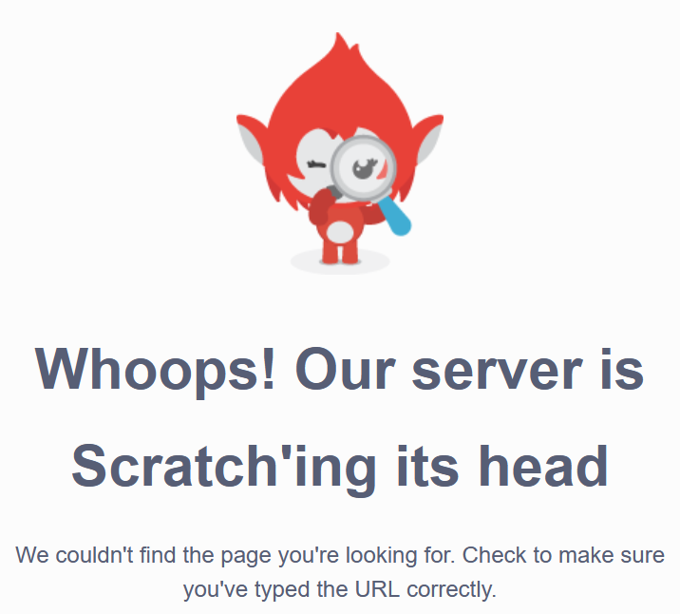
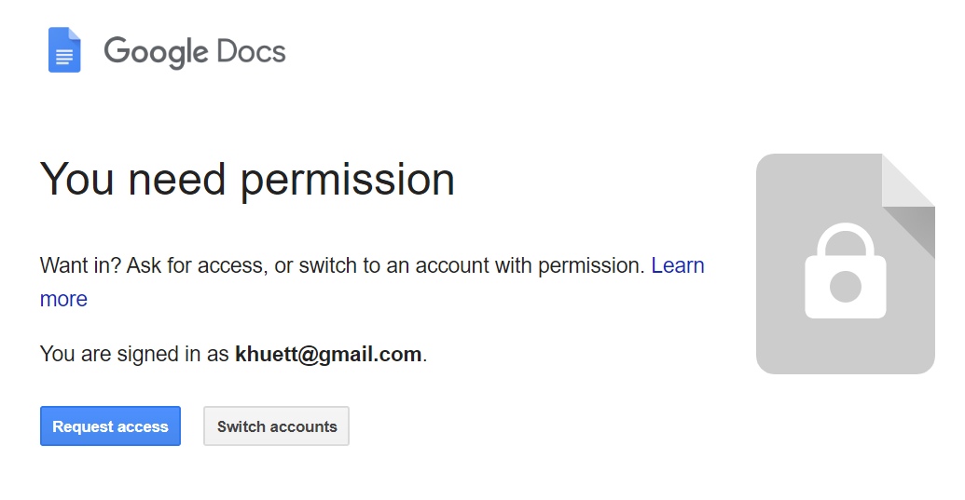
Publishing Matters
Scratch Project: Sky vs Deadlox vs King Squid
Google Doc

Slide 45
Presenting Your App
3:15 pm: Code Stop
3:15-3:25: Pack up and head upstairs to Presentation & Awards Room
All team members present when presenting for the judges.
Presenting to whole group, including Advanced Track and parents who show.
Think about how to show off your work (Lunch to 3pm).
3 minutes to Present. 1-2 minutes for Questions. (5 max)

Slide 46
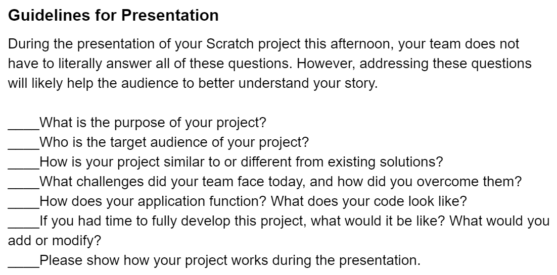
(See Page 4 of Team Packet)

Slide 47

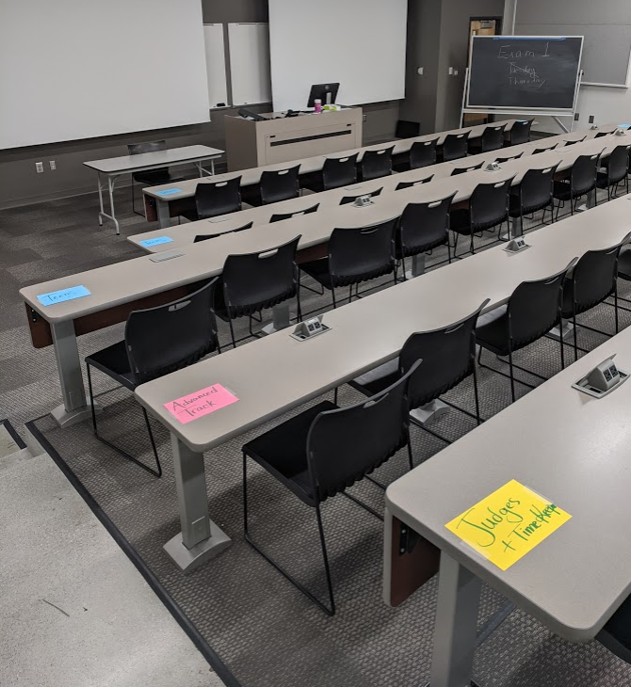
[1] Stop Working. [2] Clean Up & Pack Up. [3] Head Up to Room 125. [4] Sit in first 3 rows.
CODE STOP !
@ 3:15pm
Notes:
Display this on the screen at the moment of Code Stop. Give them verbal warnings of Code Stop around 30, 15, and 5 minutes before it occurs.

Slide 48
This concludes the slides presenting during the afternoon Work Space session.
Once the youth participants arrive at the next space for presentations and awards, this slideshow will be displaying there to guide their behavior, reminding them–and mentors, volunteers, and the community–what they need to do once they get there.

Slide 49
3:30 PM - Lecture Rm 125
Presentations

Slide 50
Seating
Schedule
Introducing the Judges
Awards Overview (Youth and Advanced)

Slide 51
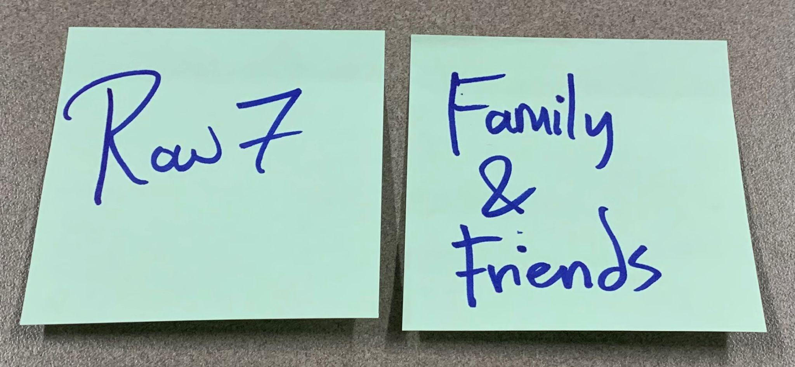
Where Do I Sit?
See Hints Taped at End of Row!
ROW 1 - Youth Teams 1 & 2
ROW 2 - Youth Teams 3, 4, & 5
ROW 3 - Advanced Track
ROW 4 - Mentors and Volunteers
ROW 5 - Judges, Photographer, Time-keeper
ROWS 6-9 - Family & Friends
Notes:
In the Mid-Size Lecture Hall for ~60 where final presentations and awards take place, we assign seating. We have this chart displayed on the PowerPoint, as well as sticky notes with cues on them on the side of each row (as depicted on the slide above). We put the Youth participants in the first 2 to 3 rows of the lecture hall. Then, we seat the Advanced Track participants in the next 1-2 rows (these are not detailed in the Hackathon Design Case, but this is a simultaneous event that allows for Youth and Adults to see what each have worked on). The next row is reserved for Judges and Volunteers (such as Photographer and Time-keeper). The remaining rows are for the public (“Family and Friends”). Exactly how the seating is assigned depends on how many attendees are participating in each hackathon strand (i.e., Youth, Advanced), and we finalize this around the middle of the day of the event once we have this attendance information.
Hackathon Contacts - https://docs.google.com/spreadsheets/d/15EHclfdnfy_gih_PTcuTE1p59UsmyTT-fZ30gcIRtG8/edit#gid=1003265375

Slide 52
Schedule
3:15pm | Code Stop | TEAL Room
3:30-4:15pm | Teen Presentations (Judges 4:15-4:45) | Room 125 Upstairs
4:15-5:00pm | Advanced Presentations (Judges, 5:00-5:10pm) | Room 125 Upstairs
5:00-5:25pm | Awards and Prizes (Youth, 5:00-10; Advanced, 5:15-25) | Room 125 Upstairs
5:30pm | Youth Check Out | Right Outside Room 125 Upstairs
Notes:
We remind the audience what the game plan is in terms of time.

Slide 53
Introducing Our Judges!
Youth
[Name], Title, Organization
[Name], Title, Organization
[Name], Title, Organization
Adult
[Name], Title, Organization
[Name], Title, Organization
K1
K2
K3
K4
Notes:
We introduce the judges for both the Youth Competition and the Advanced Competition.

Slide 54
Awards
Youth
Computing Excellence
Creativity
Highest Impact
Advanced
Customer Choice
Technical Award

Slide 55
Youth Presentations

Slide 56
Three Awards
Selected by judges
Computing Excellence
Creativity
Highest Impact

Slide 57
Computing Excellence Award
Criteria
Implemented functionality
Robustness
Variety of used programming features
Readable, well-structured code

Slide 58
Creativity Award
Criteria
Unique or Provocative Idea: Took the theme in an unexpected direction that is thought provoking, attention grabbing, and memorable.
May be expressed through any aspect of the work (e.g., user interface, content of story, coordination of teamwork, creative graphics, captivating application or story, user-friendliness, etc.).
Notes:
Great attitude award

Slide 59
Highest Impact Award
Criteria
Meets the Hackathon theme
Clearly defined purpose
Meets its purpose
Suited for target users

Slide 60
Youth Guidelines
[Organizer Name] will open your links from the Google Form spreadsheet.
3-4 Minutes to Present; 1-2 Minutes for Judge Questions (Total ~5 Minutes)
Morgan is our Timekeeper. She will hold up cards at the….
3-minute mark (presentation should end soon)
4-minute mark (presentation should be done; Q&A starts)
5-minute mark (your answers/explanations wrap up ASAP)
K1
K2
K3
K4

Slide 61
Advanced Presentations
(& Youth Judge Deliberations in Background)
Notes:
While the Advanced Participants present, a volunteer guides the Youth Judges to a nearby conference room to choose the winners.

Slide 62
~5:00 PM - No Room Change
Filler Activities
Awards Ceremony

Slide 63
Filler Activities (with Advanced Judging in Background)
Feedback Survey (4-5 Minutes)
Bingo Winner Prize
Bingo Drawing Prize
Lanyard Return Prize
Trivia-based Questions for Prizes
Announcements About Upcoming Events and Opportunities

Slide 64
Help Us Make the Hackathon Better!
Event Feedback
~4 minutes
Debrief Session in 2 Weeks: All Event Organizers + Sharing with UWG Continuing Ed & Fusion Center
Leave paper on table or pass to volunteer.
Notes:
Link to Feedback Form: https://docs.google.com/document/d/1sa6US6v5f25XwGXASSK1LdWzidQnvIR97_I5ADMcITo/edit#

Slide 65
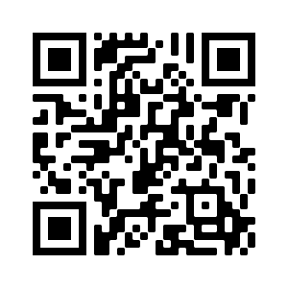
UWG Summer Camps 2022
Let your 6th -12th grader spend a week or more at any of these fantastic camps!
The University of West Georgia summer Camps offer a unique experience for sixth through twelfth graders looking to explore their passions, make new friends, and learn a lot along the way. All weekly sessions run Monday to Friday, from June 6th through July 22nd. Sign up for one or as many as you want! Some camps offered are:
Mad Scientist | Filmmaking | Shark Tank | CSI Forensic Science
Game Design & Development | Archeology | Esports | Art | and more!
For those looking for additional opportunities — sign up for the Wolf Recreational Experience, Pre-Camp Opportunities (7:30 AM-9:00 AM) and Post Camp Opportunities (3:00 PM-5:30 PM)
Explore. Learn. Fun.
LEARN MORE ABOUT ALL OF UWG SUMMER CAMPS!
https://www.westga.edu/summer-camps/

Slide 66


Slide 67



Slide 68


Slide 69


Slide 70
Awards (Youth and Adult)

Slide 71
Awards
Youth
Computing Excellence
Creativity
Highest Impact
Advanced
Customer Choice
Technical Award

Slide 72
Thank you!
All winning teams will be featured on our website at westga.edu/education/hackathon/

Slide 73
This concludes the slides presented with Participant Presentations and Awards.

